Slide 1
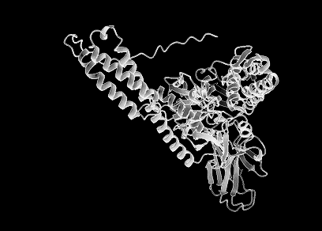
Using HMMs to find Evidence of Environmental Adaptations in Heat-Shock Proteins
SJSU Fall 2024
Thermophilic and Psychrophilic Specific Motifs in HSP70
By: Maya Talpai-Vasinthascha

Slide 2
1.
What is a HSP and their Purpose?
Partially Denatured Proteins, Renauturing & HSP70’s Role
2.
Binding Domain Specificity Hypothesis
Thermophilic versus Psychrophilic HSP70 s
3.
Design of Experiment and Results
Did the HMM pick up differences in a highly conserved protein with organisms experiencing diametrically opposed stressors
Conclusions, Future Directions & Applications
4.

Slide 3
1.
What is a HSP and their Purpose?
Partially Denatured Proteins, Renauturing & HSP70’s Role
2.
Binding Domain Specificity Hypothesis
Thermophilic versus Psychrophilic HSP70 s
3.
Design of Experiment and Results
Did the HMM pick up differences in a highly conserved protein with organisms experiencing diametrically opposed stressors
Conclusions, Future Directions & Applications
4.

Slide 4
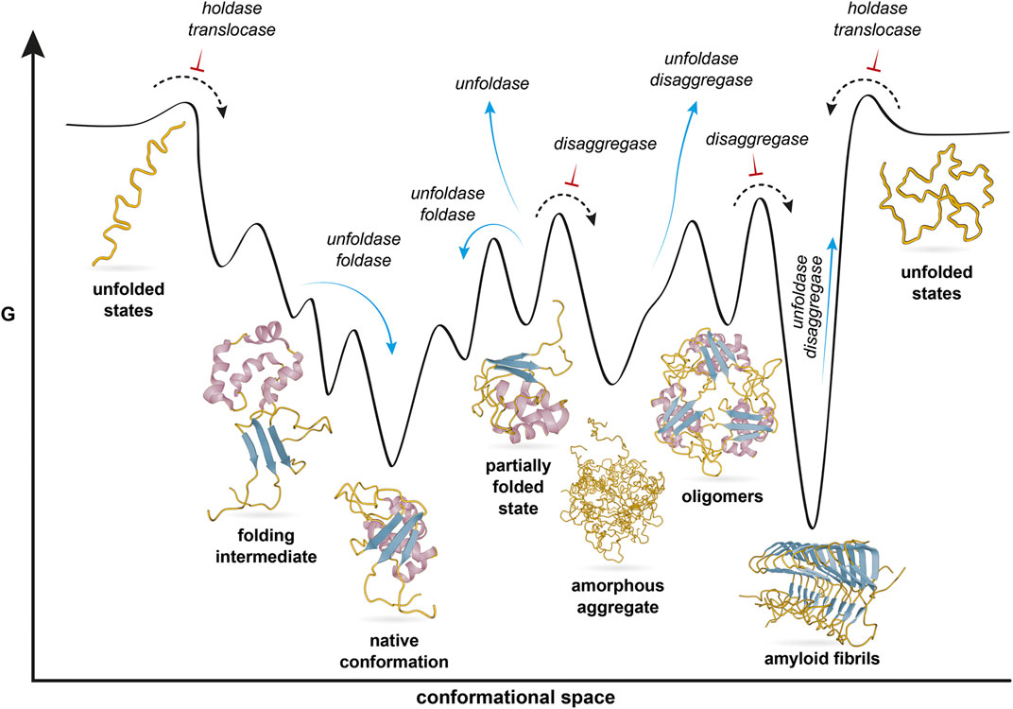
Protein Folding & Native States
2D Free Energy Folding Diagram with Chaperone Assist. Moseck et al. Front. Mol. Biosci., 14 June 2021

Slide 5
Protein Native States & Partially Denatured States
The
Good
The
Bad
The
Ugly
Denatured
Notes:
A protein on the path to a folded state has more hydrophobic exposure than the native state. Protein folding happens majority in the cytosol which is an aqueous environment.
Expect that other hydrophobic ends (in the aq. environment) of the protein want to aggregate with other self proteins and form intermediates off of the normal folding pathway to the native state.
Prions,amyloid plaque and Alzheimer's disease

Slide 6
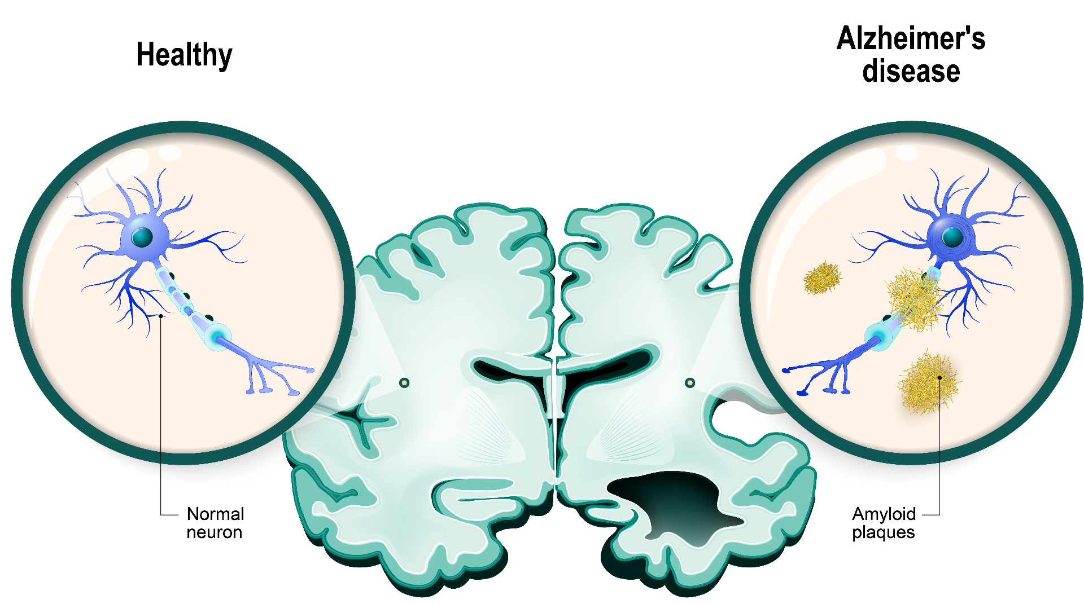
One Reason Getting Stuck in the Ugly is Very Ugly
Amyloid plaques and Alzheimer's disease.
Amyloid plaques form from misfolded amyloid-β (Aβ) peptides.
Peptides clump together to form plaques that collect between neurons.

Slide 7
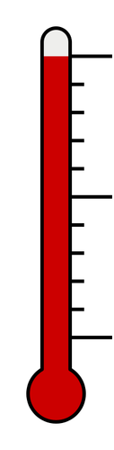
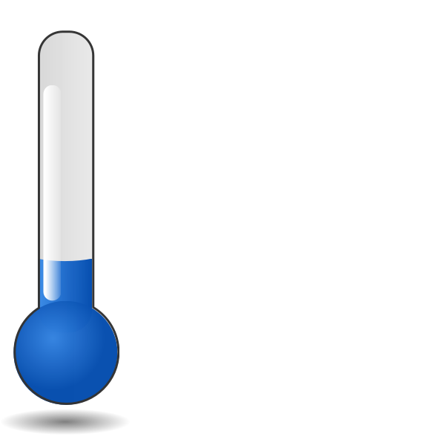

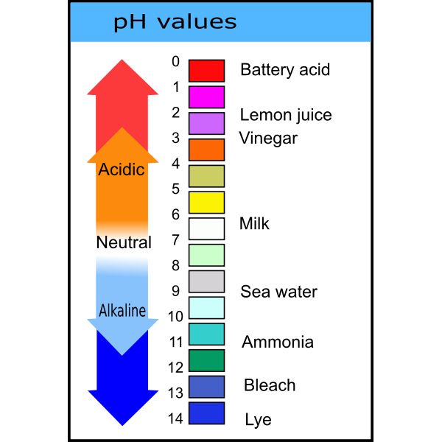
Causes of The Bad and The Ugly (Partial Denaturing)
High Temp
Low Temps
Toxins (ie. Heavy Metals)
The
Good
And The
Ugly
The
Bad
Low pH
High pH

Slide 8
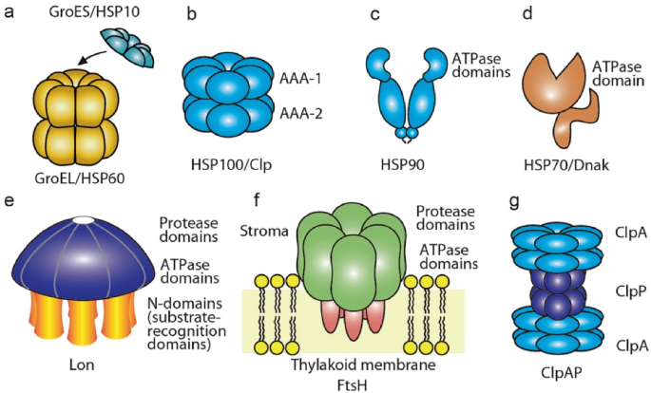
Heat Shock Proteins (HSP), are a class of proteins called molecular chaperones. They maintain proteostasis and facilitate correct protein folding by binding to “bad” denatured proteins before they turn “ugly” or aggregate.

Slide 9
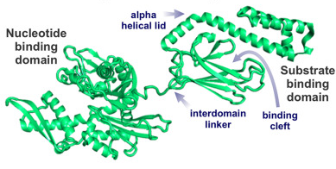
We'll focus mostly in HSP70 and its "co-chaperone", HSP40. HSP70 clamps onto hydrophobic regions of proteins which are more prevalent in unfolded and partially folded proteins and helps refold them through repeated cycles of binding and release dependent on ATP cleavage.
HSP70 is made up of two regions:
The nucleotide binding domain (NBD)
Low ATPase activity
located in the N-terminal.
HPD Binding Motif
The substrate binding domain (SBD)
Located in the carboxyl terminal end.
Has a Beta Sheet where denatured protein binds
Has an Alpha-Helical region that acts as the clamp (open/closed)

Slide 10
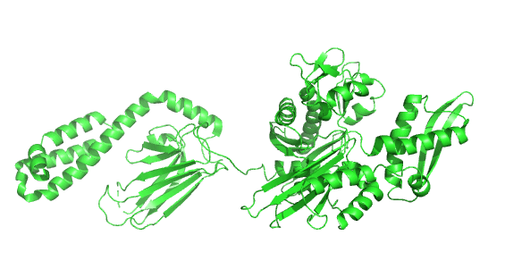
We'll focus mostly in HSP70 and its "co-chaperone", HSP40. HSP70 clamps onto hydrophobic regions of proteins which are more prevalent in unfolded and partially folded proteins and helps refold them through repeated cycles of binding and release dependent on ATP cleavage.
HSP70 is made up of two regions:
The nucleotide binding domain (NBD)
Low ATPase activity
located in the N-terminal.
HPD Binding Motif
The substrate binding domain (SBD)
Located in the carboxyl terminal end.
Has a Beta Sheet where denatured protein binds
Has an Alpha-Helical region that acts as the clamp (open/closed)

Slide 11
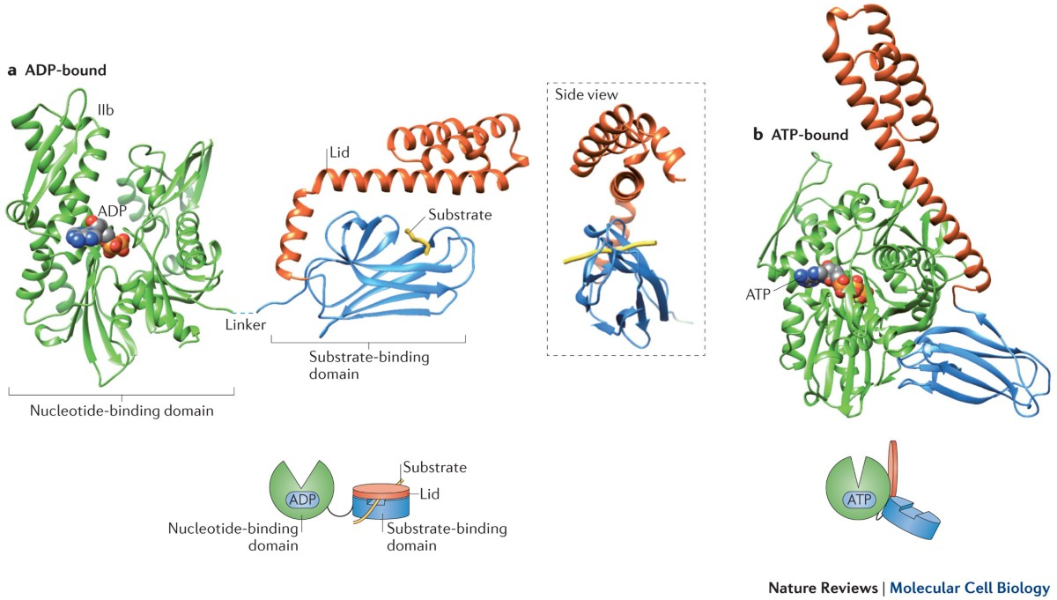
HSP70 Open State
HSP70 Closed State

Slide 12
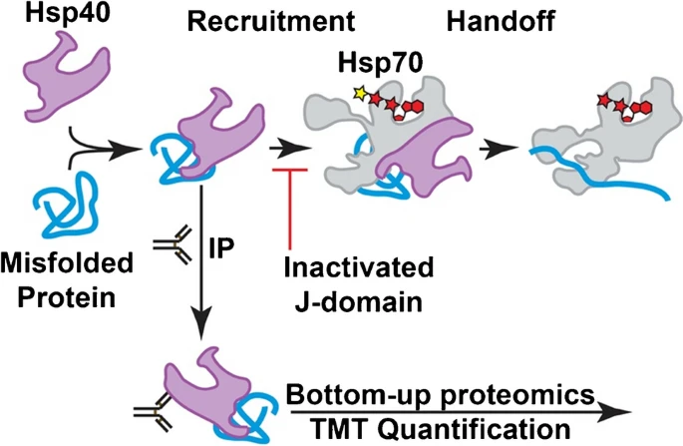
HSP40 Diversity and Co-Chaperone Relationship to HSP70
Detachment
HSP40s assist HSP70s in protein folding mainly through two mechanisms: stimulating ATP hydrolysis and bringing misfolded proteins directly to Hsp70s. HSP40s has a lot of diversity in terms of specificity in the misfolded proteins it directs to HSP70. HSP40 binds with HSP70 through an histidine-proline-aspartic acid motif (HPD).

Slide 13
1.
What is a HSP and their Purpose?
Partially Denatured Proteins, Renauturing & HSP70’s Role
2.
Binding Domain Specificity Hypothesis
Thermophilic versus Psychrophilic HSP70 s
3.
Design of Experiment and Results
Did the HMM pick up differences in a highly conserved protein with organisms experiencing diametrically opposed stressors
Conclusions, Future Directions & Applications
4.

Slide 14
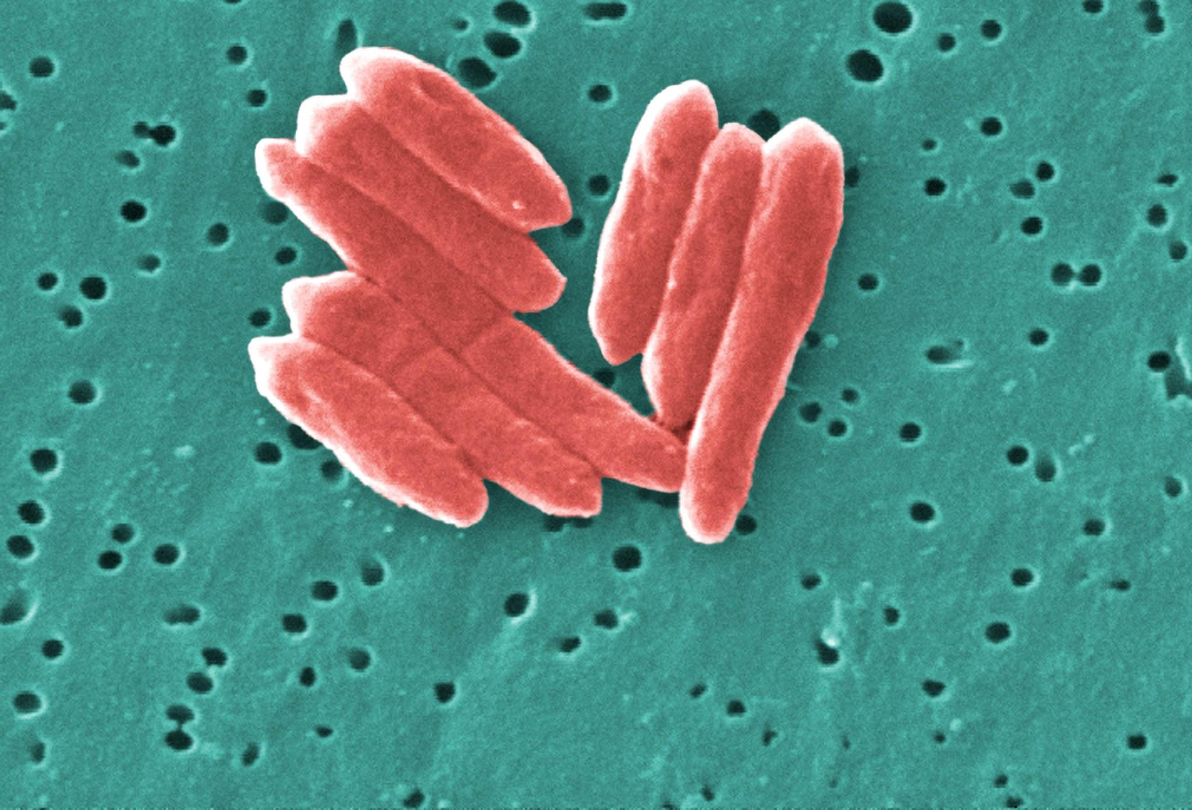

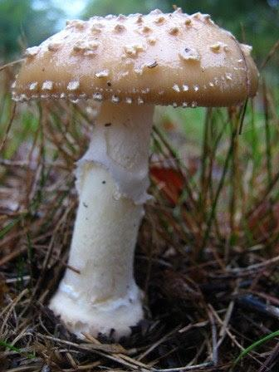
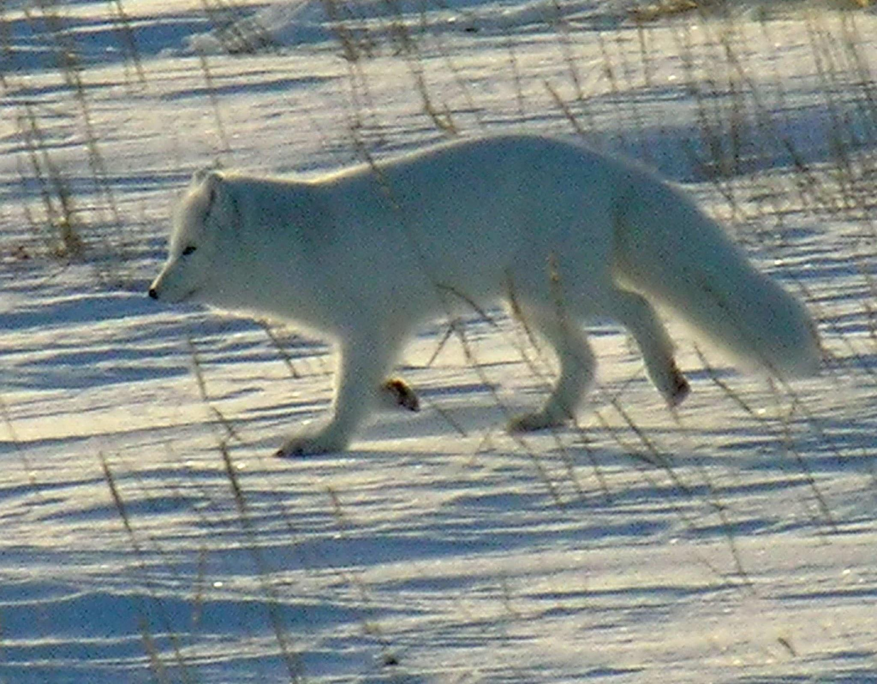
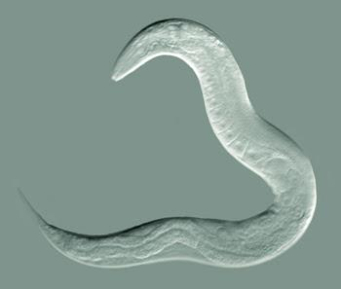
HSP70 is a highly conserved protein that is found across all domains (Plants, Animals, Fungi, Bacteria, Archaea).
All of whom survive in dramatically different environments and experience different kinds of environmental stress.

Slide 15
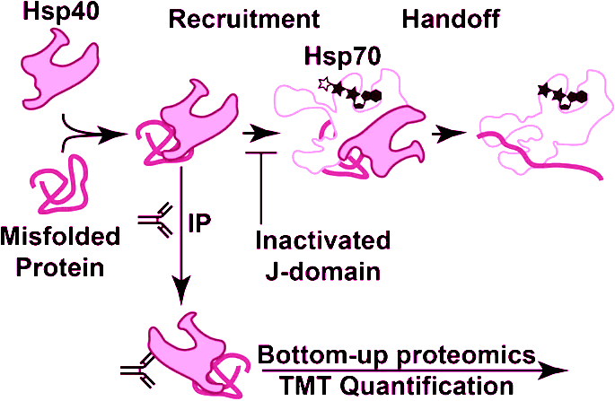
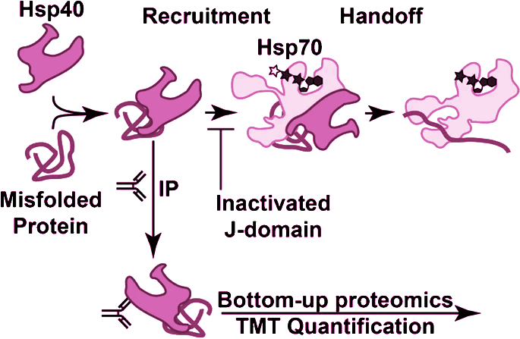
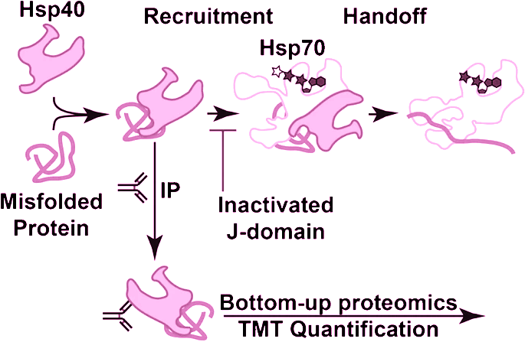

Hypothesis:
There is an evolutionary driving force that can bias one HSP70s to be better suited than others for a particular environmental stressor.
HSP40 has an affinity to the type of misfolded proteins it binds to. If a species experiences a specific environmental stressor often, there could be a bias in the types of proteins that get misfolded more often.
This repertoire of misfolded proteins could influence the diversity of HSP40s and by consequence the histidine-proline-aspartic acid motif (HPD) in HSP70.
A protein that is sensitive to high temps
Selection favors HSP40 that attaches to this specific protein
HSP40 & Protein specific recruitment
Selection for HSP70 that has a particular HPD binding site to the protein specific HSP40
High Temp Stress

Slide 16
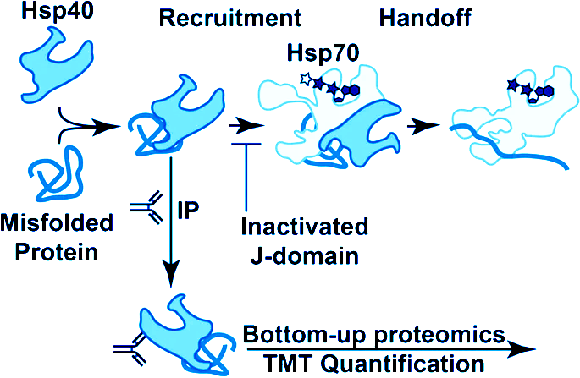
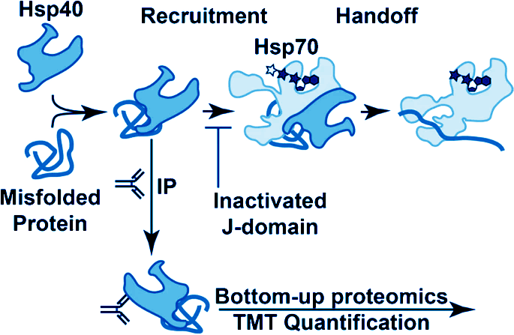
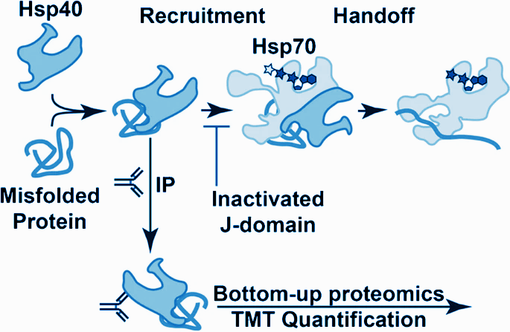

HSP70 sequence will differ slightly in organisms that are cold-tolerant versus heat-tolerant and a HMM would be able to pick out heat/cold tolerant.

Slide 17
1.
What is a HSP and their Purpose?
Partially Denatured Proteins, Renauturing & HSP70’s Role
2.
Binding Domain Specificity Hypothesis
Thermophilic versus Psychrophilic HSP70 s
3.
Design of Experiment and Results
Did the HMM pick up differences in a highly conserved protein with organisms experiencing diametrically opposed stressors
Conclusions, Future Directions & Applications
4.

Slide 18
Step 1: Collect Sequences
Thermophilic versus Psychrophilic
High Temp
Low Temps
Thermophiles are a type of extremophile that can survive and thrive in high temperatures (41°C and 122°C).
Psychrophiles or cryophiles are a type of extremophile that survive in low temperatures (−20 °C and 20 °C)

Slide 19
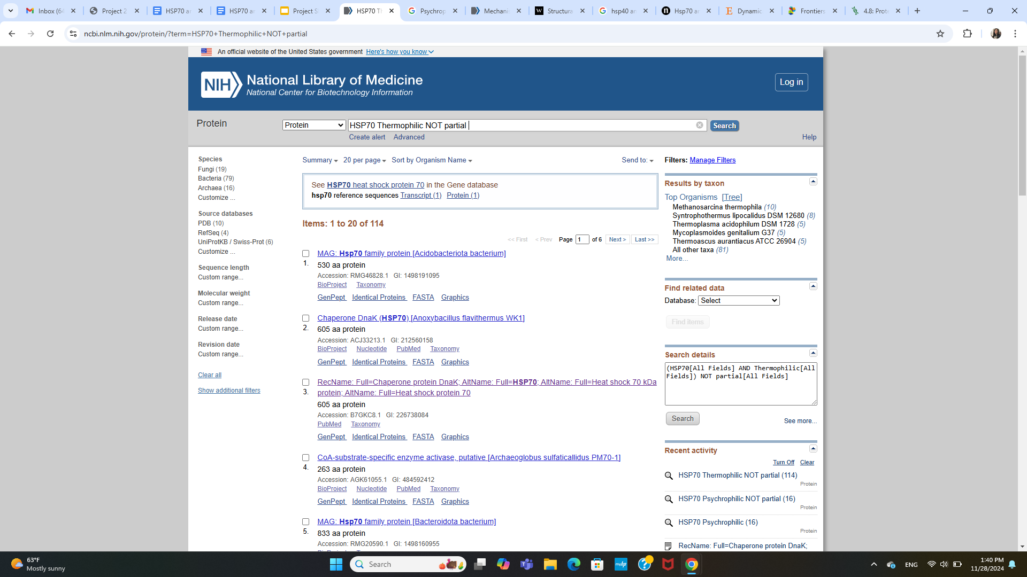
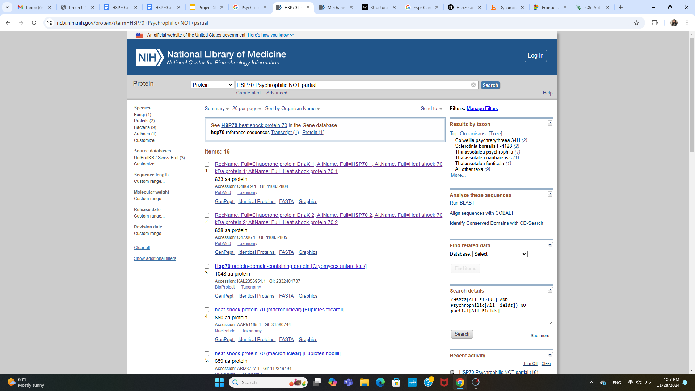
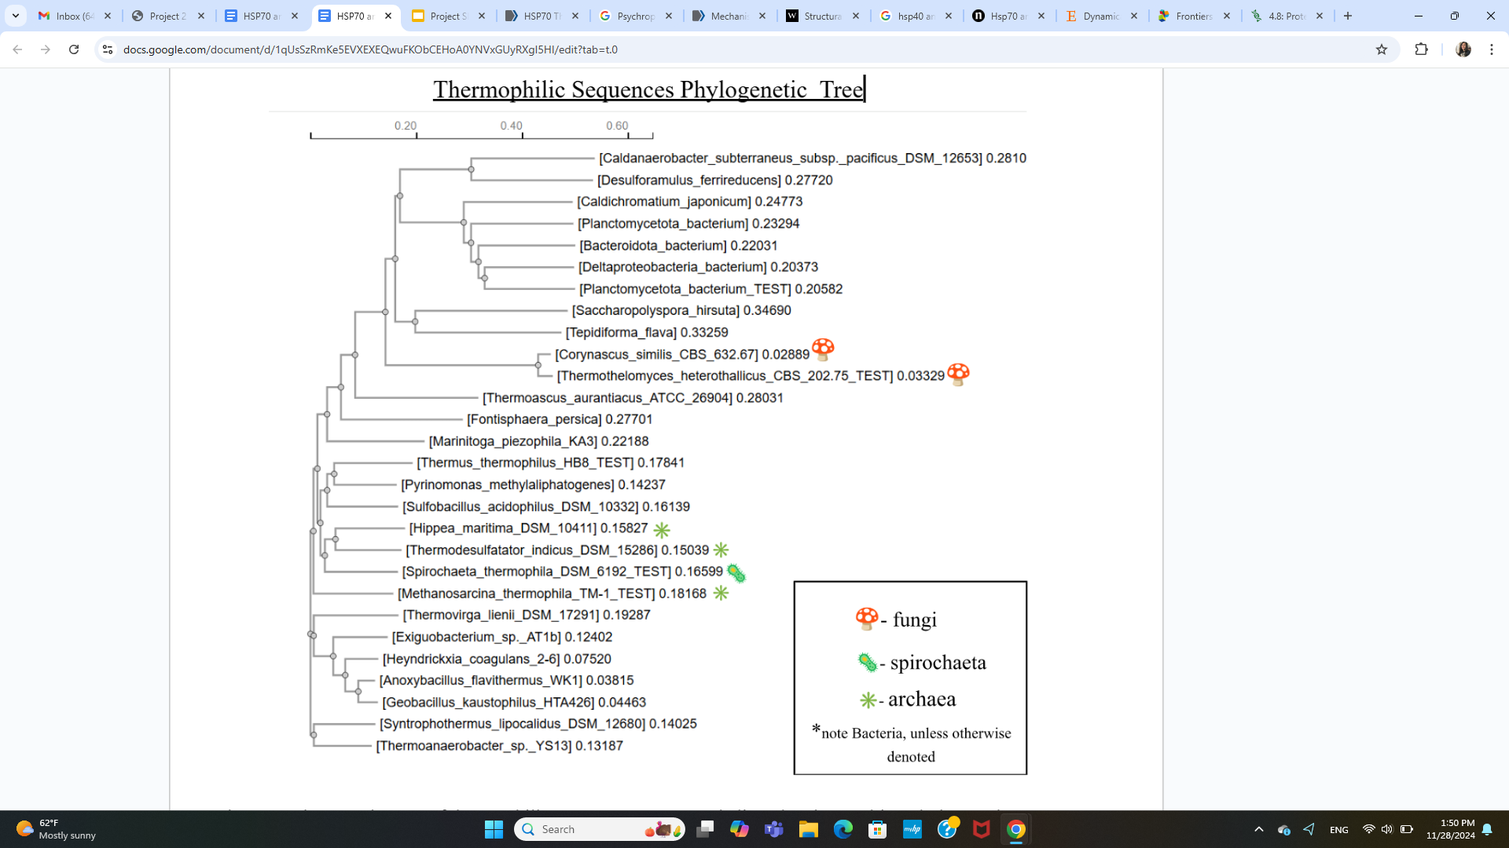
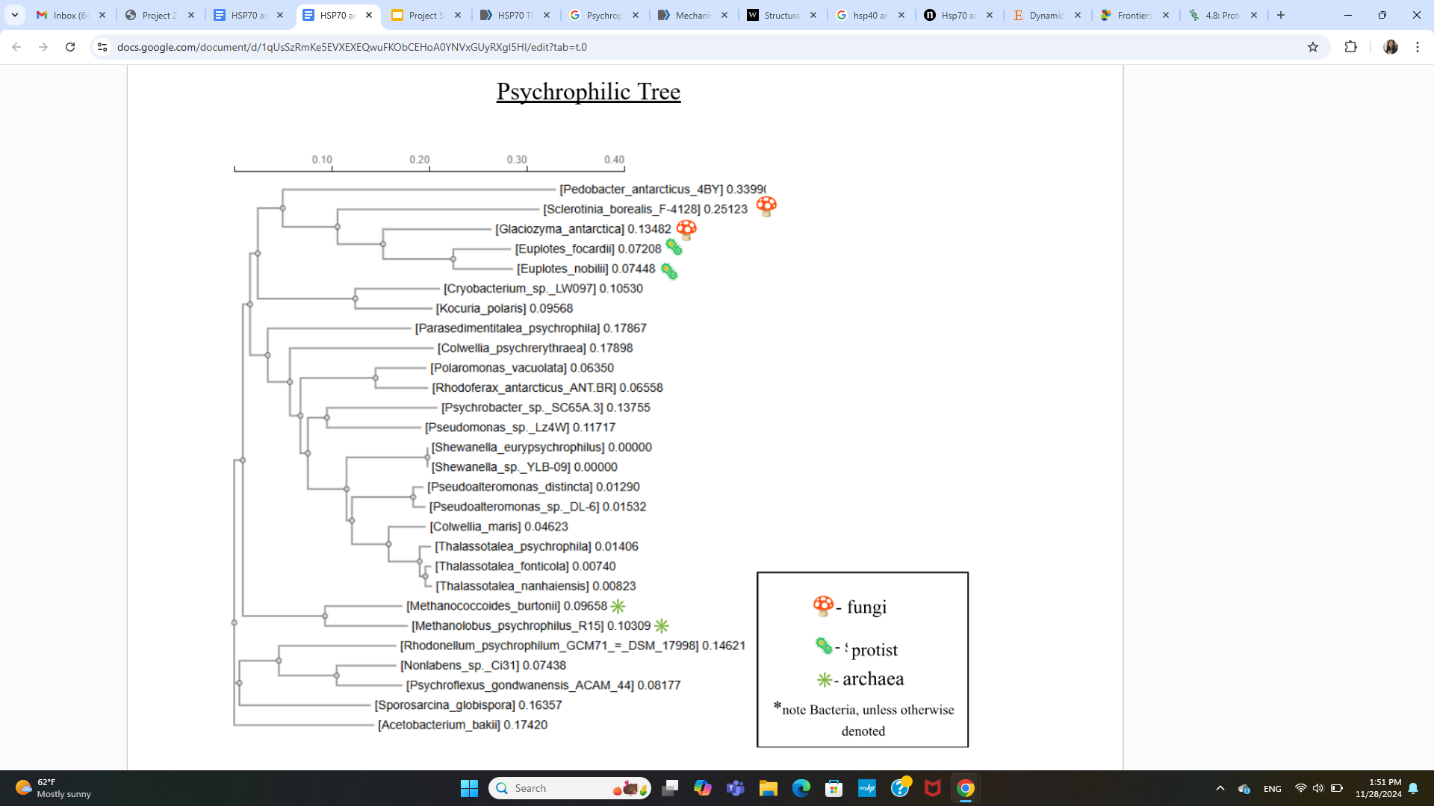
Thermophilic (28x)
Psychrophilic (28x)

Slide 20
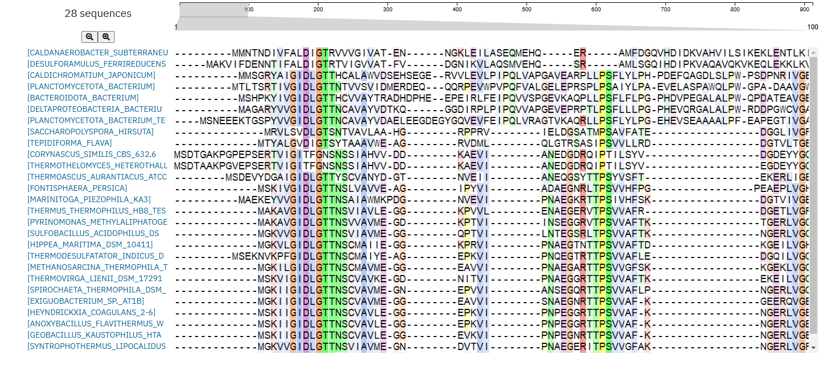
Step 2: CLUSTAL-W to Align Sequences (~600 AA) and Create Phylogenetic Trees

Slide 23
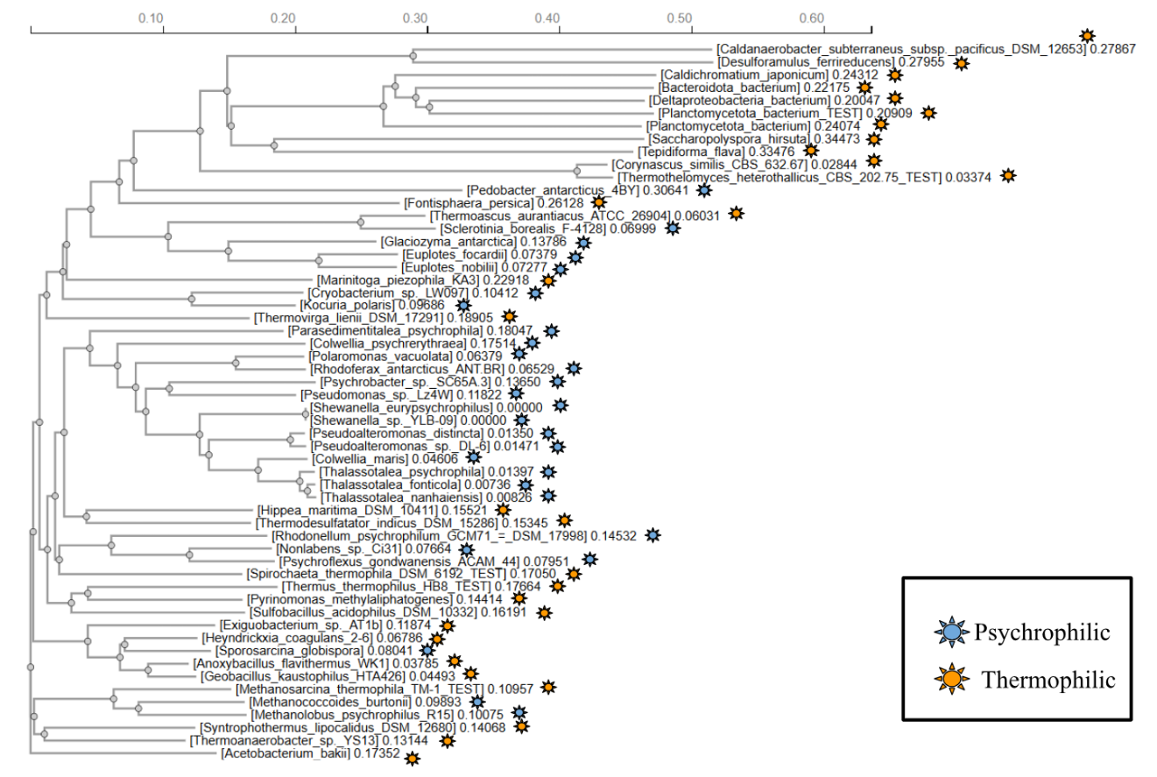
&

Slide 24
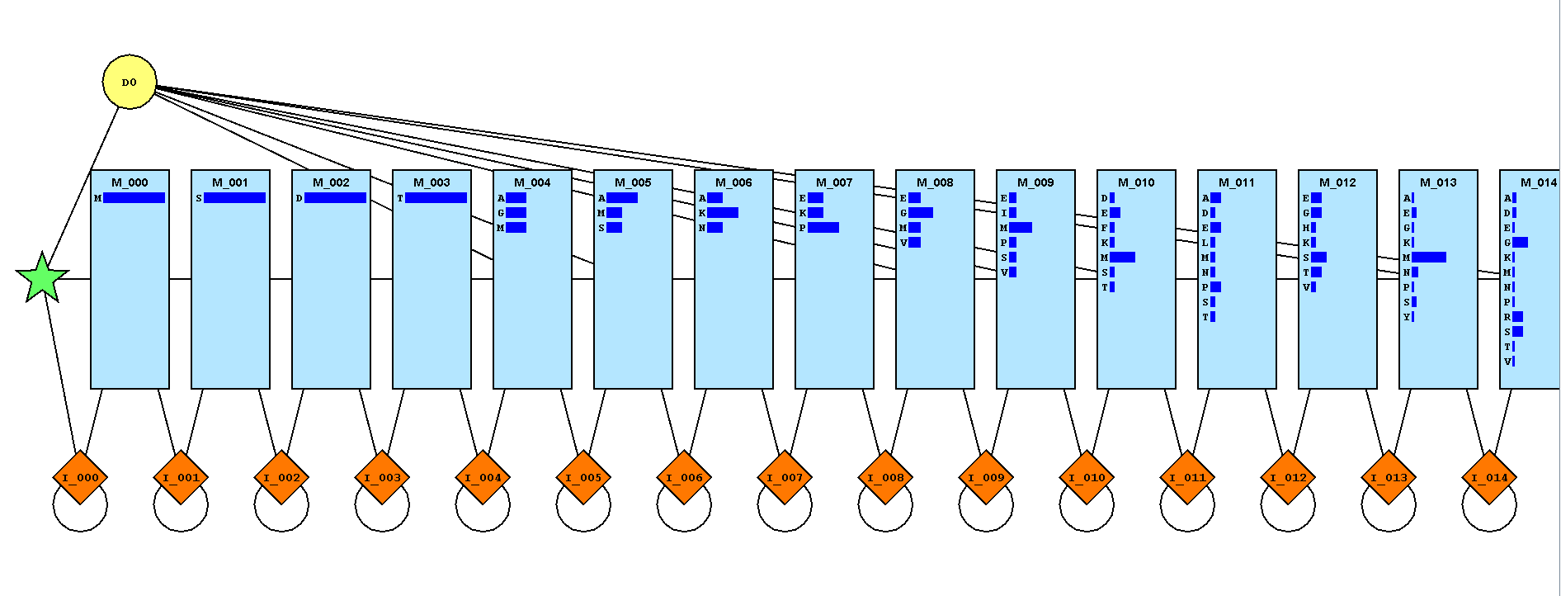
Step 3: Train one HMM in a Subset of Psychrophilic
and Another in Thermophilic Sequences

Slide 25
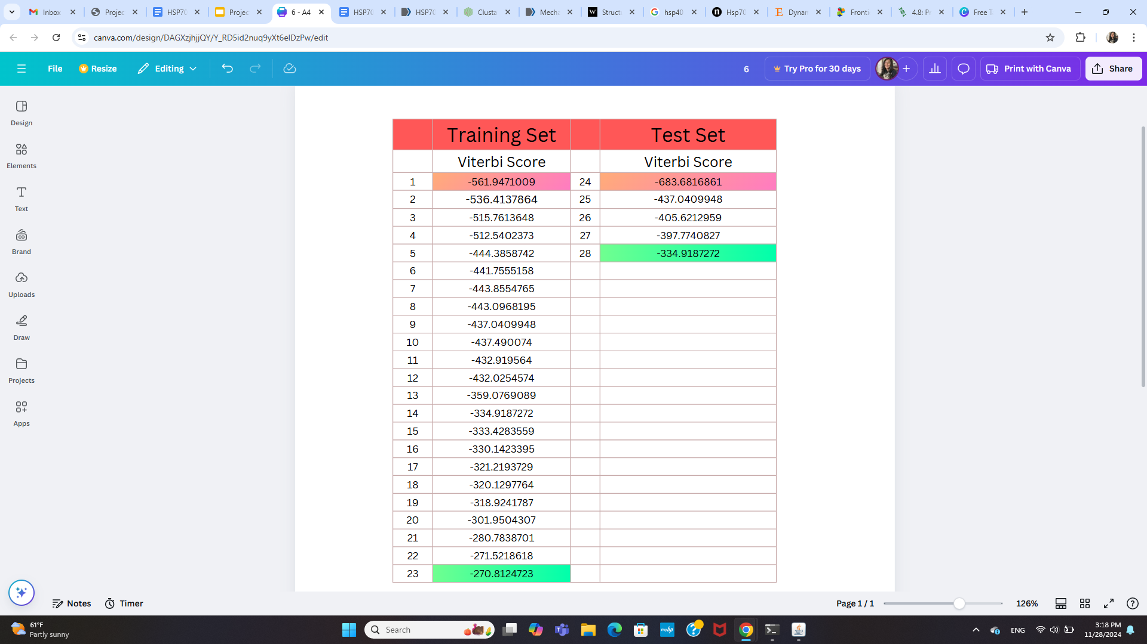
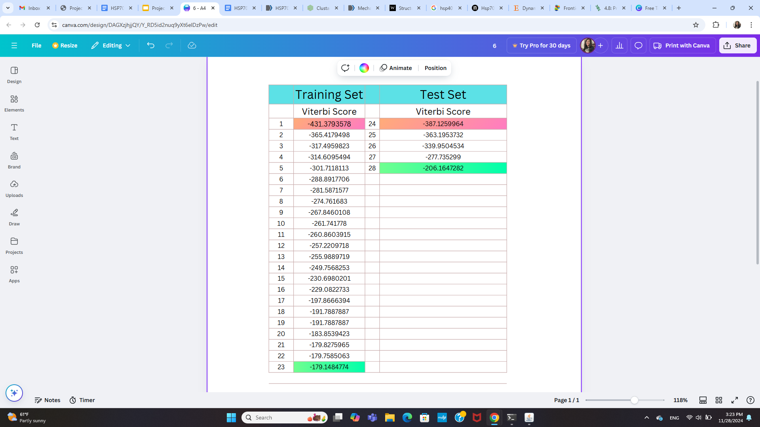
Training Thermophilic Viterbi
Training Psychrophilic Viterbi
Notes:
Gives us the range that we would expect to see Thermophilic or Psychrophilic sequences. They trained pretty similarly, but if I were to test Psychrophilic scores into the Thermophilic model, would it score worse or better? What about visa vera? Would known psychrophilic sequences score within the range that the trained psychrophilic sequences? What about visa vera?

Slide 26
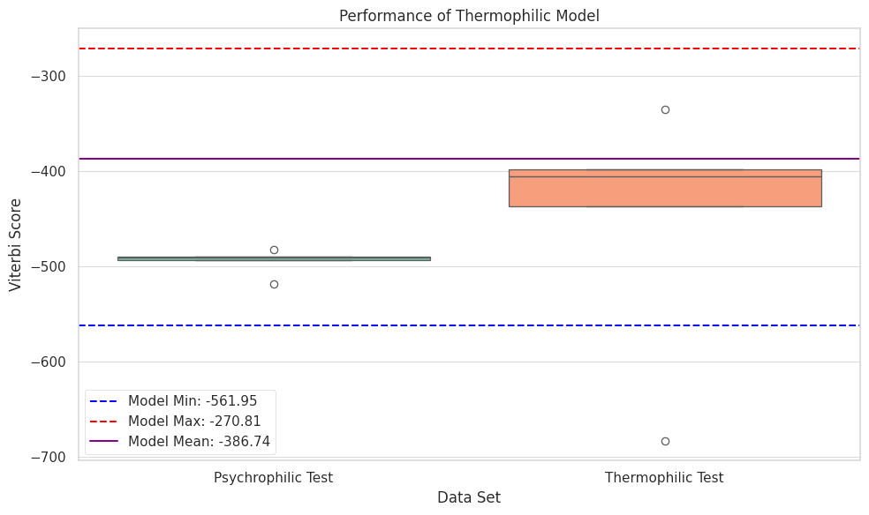
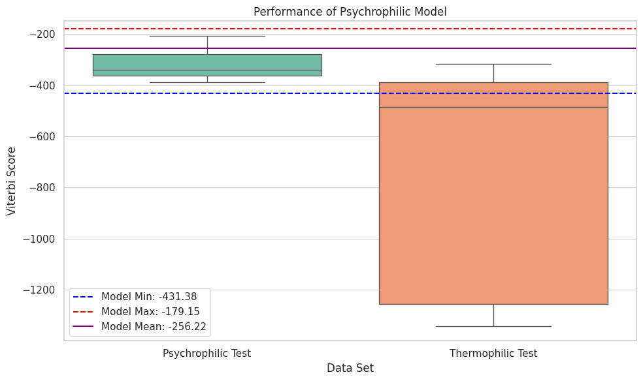
Step 4: Take the set aside subset of Non-Training seqs and obtain the Viterbi Scores for the known Thermophilic or Psychrophilic sequences. Compare.

Slide 27
Performance of of the Thermophilic Model

Slide 28
Performance of of the Psychrophilic Model

Slide 29
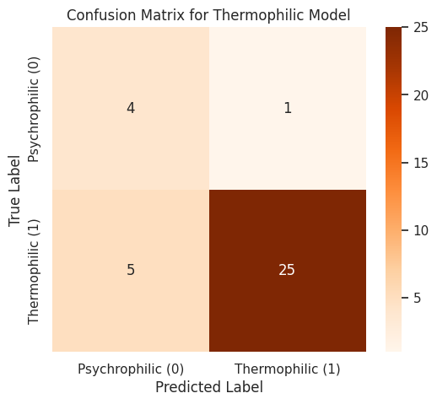
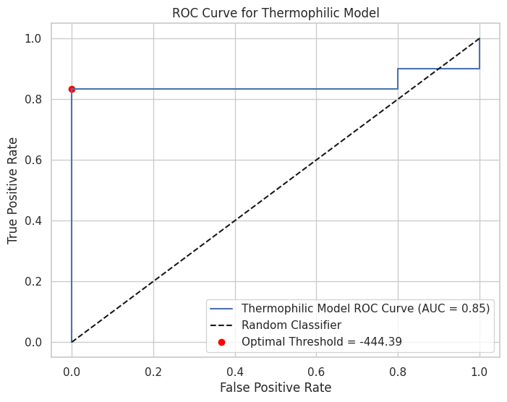
Step 5: Determine the likelihood of misclassifying a sequence as Thermophilic or Psychrophilic given a Viterbi Score Threshold. (Confusion Matrix and ROC)

Slide 30
Is there a good cut off viterbi score that will get all the Thermophilic sequences, and exclude all the Psychrophilic?
Performance of of the Thermophilic Model
-482.6

Slide 31
Confusion Matrix: If I just get all the sequences that score -482.6 or higher, what is the likelihood I will misclassify an unknown thermophilic sequence?

Slide 32
Receiver Operating Characteristic Curve: What is the optimal Viterbi Score Threshold to maximize sensitivity (correctly identifying true thermo seqs) while mitigating false positives?

Slide 33
Is there a good cut off viterbi score that will get all the Psychrophilic sequences, and exclude all the Thermophilic?
Performance of of the Psychrophilic Model
-431.37

Slide 34
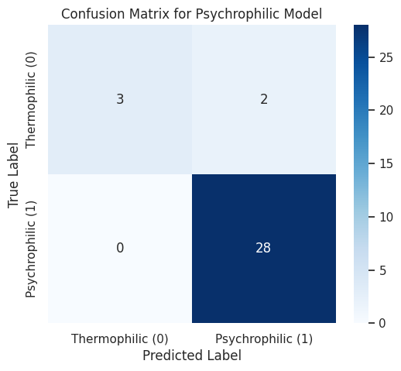
Confusion Matrix: If I just get all the sequences that score -431.37 or higher, what is the likelihood I will misclassify an unknown psychrophilic sequence?

Slide 35
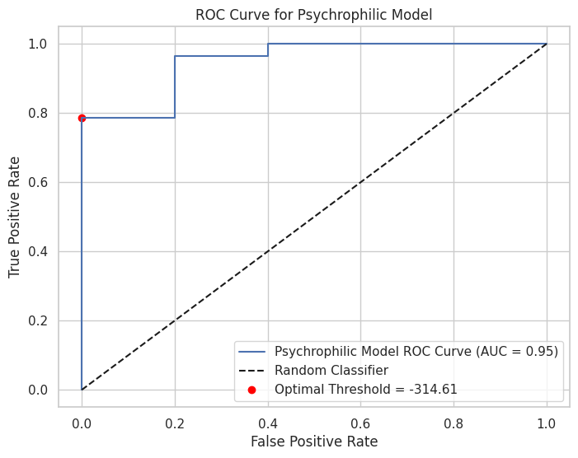
Receiver Operating Characteristic Curve: What is the optimal Viterbi Score Threshold to maximize sensitivity (correctly identifying true psychro seqs) while mitigating false positives?

Slide 36
Step 6: Determine How Well Closest Relative Pairs Viterbi Scores Rank Between Each Other from Phylogenetic Trees

Slide 38
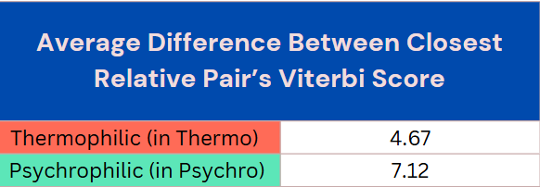
Do Closest Relative Pairs in Phylogenetic Tree Receive a Similar Viterbi Score?

Slide 39
1.
What is a HSP and their Purpose?
Partially Denatured Proteins, Renauturing & HSP70’s Role
2.
Binding Domain Specificity Hypothesis
Thermophilic versus Psychrophilic HSP70 s
3.
Design of Experiment and Results
Did the HMM pick up differences in a highly conserved protein with organisms experiencing diametrically opposed stressors
Conclusions, Future Directions & Applications
4.

Slide 40
Conclusions
Given a thermophilic trained model, known thermophilic and psychrophilic sequences overlap significantly within the expected viterbi score of trained thermophilic sequences. Poor at classification. A sign of tainted psychrophilic sequences in thermophilic set?
Given a psychrophilic trained model, known thermophilic and psychrophilic sequences overlap only slightly within the expected viterbi score of trained Psychrophilic sequences. Pretty good at classification!
However, there is noticeable differentiation between known thermophilic & psychrophilic sequences in each model despite there being some overlap in expected viterbi score.
We can optimize known psychrophilic & thermophilic classification in the HMMs using thresholds at these noticeable differentiations
Psychrophilic & thermophilic create noticeable clades. Close relatives show little difference in viterbi score in their respectively trained models, showing some evolutionary basis in HSP70 & environmental adaptations

Slide 41
Further Directions
Deep dive into what the specific sequence motif difference is between thermophilic and psychrophilic organisms. Use applications like MEME that use HMMs to detect sequence motifs. Is there a difference at the histidine-proline-aspartic acid motif (HPD) where HSP40 binds?
Double check for sample tainting. See if with more samples if there is better division between thermophilic and psychrophilic sequences in HMM. See if this distinguishing pattern holds up with more biodiversity (more animals & plants HSP70 sequences)
See if we can see this same distinguishing pattern in HSP70 with other extremophiles, such as halophiles (salt-lovers).
A more thorough evolutionary analysis by finding clades of known thermophilic & psychrophilic sequences first instead of analysing how closely related species are after.

Slide 42
Applications
If there are some organisms better suited for an environment than other organisms, can we genetically engineer HSP70/HSP40 of vulnerable organisms to better handle environmental stress?
Genetically engineered crops better suited for heat/drought related stress
Genetically enhanced endangered organisms to better handle climate change
Genetically engineered human HSP70 proteins that better unfold amorphous aggregates that cause alzheimer's
Can we use HSP70/HSP40 proteins as “canaries in a coal mine” for how organisms handle environmental stressors in a rapidly changing environment?

